Slide 1

ML in Applications
Dipartimento di Automatica e Informatica
Politecnico di Torino, Torino, ITALY

Slide 2
Dealing with real world data

Slide 3
Datasets
When discussing machine learning models, there is usually the assumption that the network has access to a large number of clean annotated data which is balanced between classes. When applying ML in a real environment these conditions are rarely encountered, and as such it is important to know how to offset these factors and obtain working models from flawed data.
Slide credit: L. Lazebnik

Slide 4
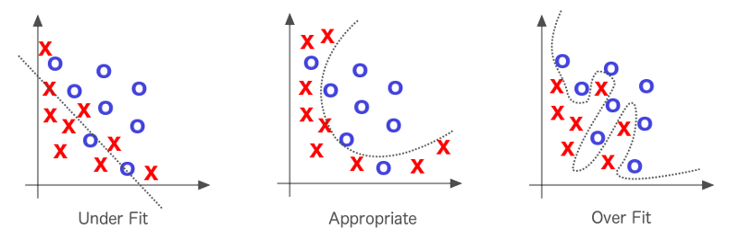
Small Datasets
A complex model on a small dataset will learn noise in addition to the signal.
Note that all three solutions above could be appropriate depending on the problem
Slide credit: L. Lazebnik

Slide 5
Isolating Noise
The network needs to learn to identify what is noise, and to do so it necessarily needs a lot of samples, depending on the amount of noise and complexity of the task to perform
Slide credit: L. Lazebnik

Slide 6
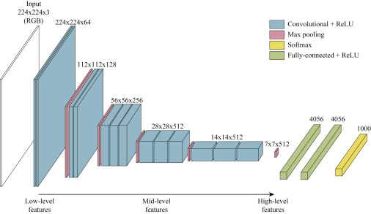
Feature Extraction
After pretraining a network on a different dataset, we can separate the convolutional part from the fully connected, obtaining a feature extractor. We can then train a classifier to perform our task using the features. By doing this we lower the complexity of the problem (we only have one or a few layers to train), significantly reducing the chances of overfitting
Slide credit: L. Lazebnik

Slide 7
Which dataset to pretrain on?
The most common is ImageNet, but lately the landscape is evolving with more varied and sizeable datasets that can provide more versatile features
Big research models make wide use of pretraining on massive datasets.
Slide credit: L. Lazebnik

Slide 8
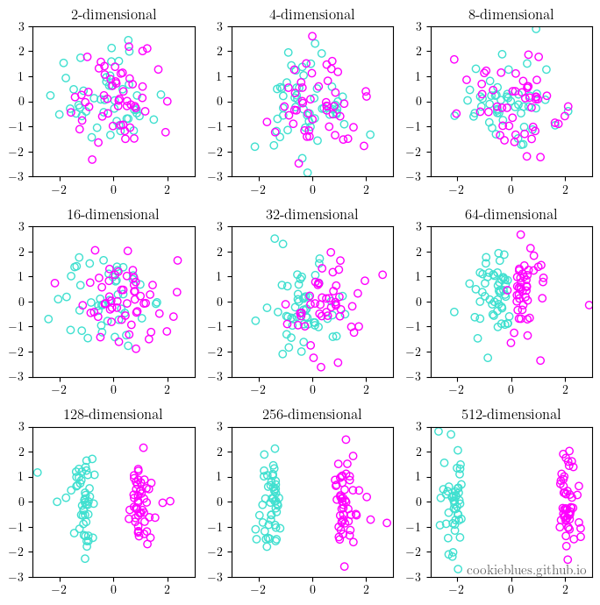
Curse of Dimensionality
Latent spaces of neural networks usually have high dimensionalities, which makes the data sparse.
Often times very complex tasks in pixel space can be linearly separable in the latent space.
A SVM with a kernel is a good example
Slide credit: L. Lazebnik

Slide 9
The dataset is small: Reducing paramaters

Slide 10
Types of receptive fields
The way layers are connected together affects the behaviour of the network as well as having a strong impact on the number of parameters.
Two layers can be connected in the following ways:
Fully Connected: Every neuron is connected to every other neuron
Convolutional: Small local receptive field, weights shared while moving the window, translational invariance
Recurrent: The data is sequentially passed through the same neuron, often has some memory mechanism
Attention: Learned receptive field, function of weights, data point content and context
Slide credit: L. Lazebnik

Slide 11
Types of receptive fields
Fully Connected layers are often very expensive, as the number of parameters is the product of the number of neurons in the connected layers. On the other hand the high number of parameters enables the learning of arbitrarily complex relationships.
Convolutional layers allow connection of layers with a large number of neurons with few weights, in contexts where locality and translational invariance are important these layers are invaluable.
Recurrent layers allow sparse connections, which are useful in contexts like language where important associations are formed between far away tokens. Recurrent layers are difficult to parallelize, and as such tend to be slow despite the low number of parameters.
Attention tries to model sparse connections by connecting similar neurons based on the information and learned parameters.
Slide credit: L. Lazebnik

Slide 12
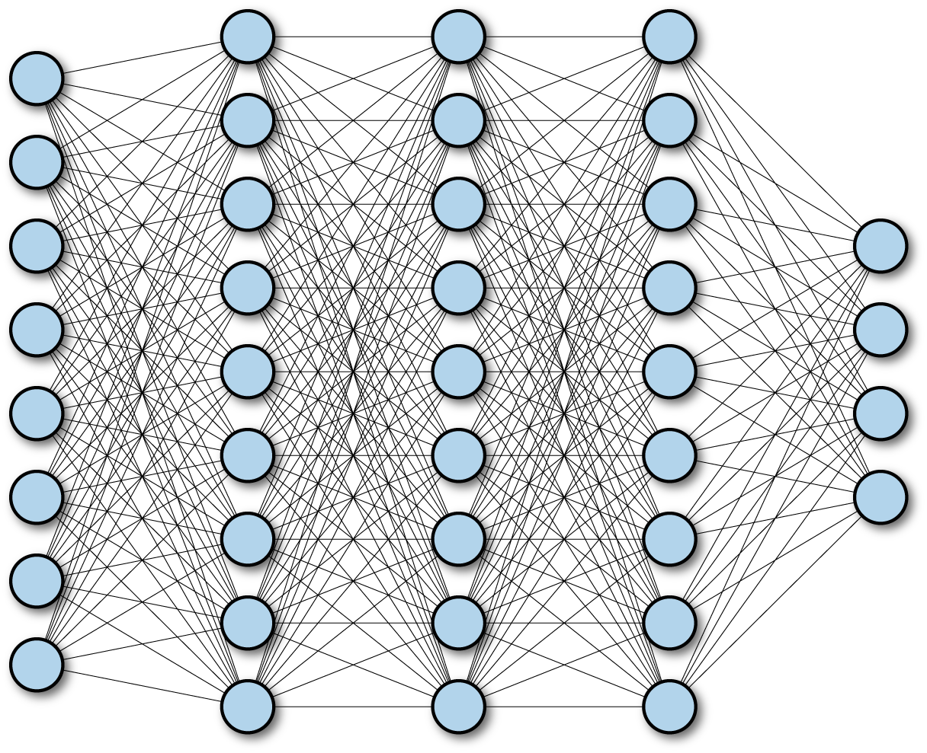
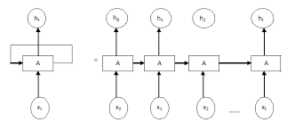
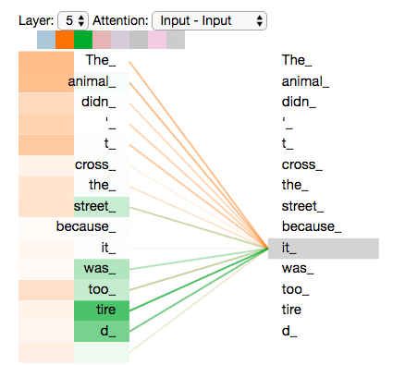
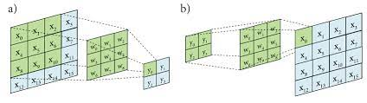
Types of receptive fields
Slide credit: L. Lazebnik

Slide 13
Reducing the number of parameters
The most important tool we can use to deal with small datasets is reducing the number of parameters in our model, and one of the best way to do so is evaluating the receptive fields used and the way they interact with the number of neurons in the layers.
A network with a low number of parameters will learn to generalize on a small dataset without overfitting, in particular reducing the use of FC layers can produce a significant reduction in parameters. In these cases convolutional layers and attention should be used as a replacement for FC layers anywhere possible, and FC layers need to have as few neurons as possible.
Example: Replacing the Flatten layer in a CNN with a Global Average Pooling can significantly reduce the number of connections in the following FC layer, removing more than half of the parameters from some architectures.
Slide credit: L. Lazebnik

Slide 14
Inductive Bias
Every architecture has some innate behaviours caused by the layers and the connections it has. CNNs identify features regardless of their position, leading to adversarial attacks, variational autoencoders generate blurry images, deep architectures tend to learn complex functions regardless of the complexity of the task. There are plenty of knowledge and assumptions that are embedded when the architecture is designed: the size, number and connection of the layers as well as the loss functions, regularization and input/output all represent different ways of giving knowledge to the network before it even starts training
Slide credit: L. Lazebnik

Slide 15
Inductive Bias
Reducing parameters inherently reduces the predictive power of the network, but we can offset part of such loss by using the architecture design process to embed some useful information into the network. Examples:
If the output has to be categorical we employ a softmax activation function to force the output we expect .
If there is a need to correct for perspective in an image a custom layer can substitute multiple convolutional layers with a fraction of weights .
If an intermediate layer can be represented as a standard normal distribution we can use a regularization to drive the network towards that behaviour.
If two images are supposed to be similar but not equal, we can employ a perceptual loss to let the network know it has to ignore translation and noise. If two images have to be equal we can employ MSE instead.
Slide credit: L. Lazebnik

Slide 16
The dataset is small: Increasing the data available

Slide 17
Pretraining
We can use a different dataset to offer additional knowledge to a network by performing pretraining. By training the pretrained network on the new dataset, the network will have very good initial weights, enabling better convergence before overfitting happens.
It is important to limit the amount of training epochs when fine-tuning in this way, as due to catastrophic forgetting the pretraining information will be lost after enough steps on the new dataset.
Slide credit: L. Lazebnik

Slide 18
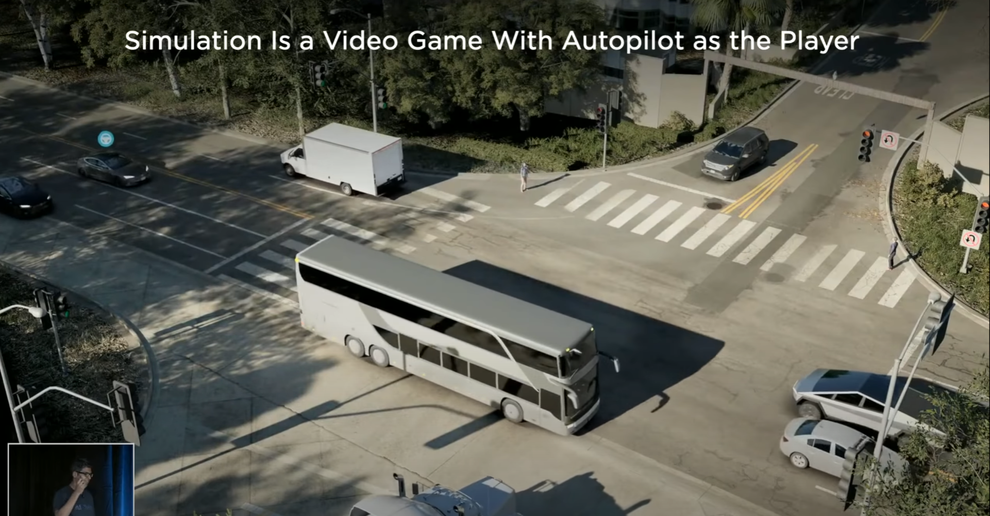
Simulations
Computer generated datasets are common in industry and are very useful as the network can use all kinds of supervised data that may be impossible to acquire in the real world. Generating data can be useful both for pretraining as well as for data augmentation.
Example:
Tesla Motors uses a videogame to train their self driving machine learning algorithms
Slide credit: L. Lazebnik

Slide 19
Additional loss functions
The potential for overfitting is reduced when the problem is more complex. While we do not want our main task to be more difficult, as we want the highest performance for our model, we can add additional tasks using whatever data was produced together with our dataset.
Example:
When classifying birds, we can have an additional task of localizing them in the image. This makes our task harder reducing the potential for overfitting.
Slide credit: L. Lazebnik

Slide 20
One class is severely underrepresented

Slide 21
Underrepresentation
Sometimes the classes are severely imbalanced due to the nature of the dataset, a dataset of credit card fraud for example will have the vast majority of data points belonging to the “not fraud” class.
How do we deal with this?
Slide credit: L. Lazebnik

Slide 22
Outlier Detection
We can build an algorithm to identify how similar the data is to the most represented class and classify images with low similarity as anomalous. This can be useful when we only have one class that is underrepresented and there is plenty of annotated data for the others.
Slide credit: L. Lazebnik

Slide 23
Semi Supervised Learning
We can employ unsupervised techniques to help our network develop an understanding of the problem.
Once we have a latent representation of our data simpler ML techniques which requires significant smaller amounts of data (e.g. SVMs) can be employed for the final classification.
Slide credit: L. Lazebnik

Slide 24
The dataset is unlabeled

Slide 25
Unlabled Data
It’s often easy for organizations to acquire large amounts of unlabeled data.
While this data may not be useful in training a traditional convolutional classifier, we can employ it to develop domain specific feature embeddings
Slide credit: L. Lazebnik
Notes:
25

Slide 26
Embeddings
Image embeddings are a compact representation of the important features of an image.
In an image classifier, these tend to be the features that allow the identification of classes, e.g. the shape of the eyes for an animal classifier, or the presence of wheels for a network that classifies vehicles
Slide credit: L. Lazebnik
Notes:
26

Slide 27
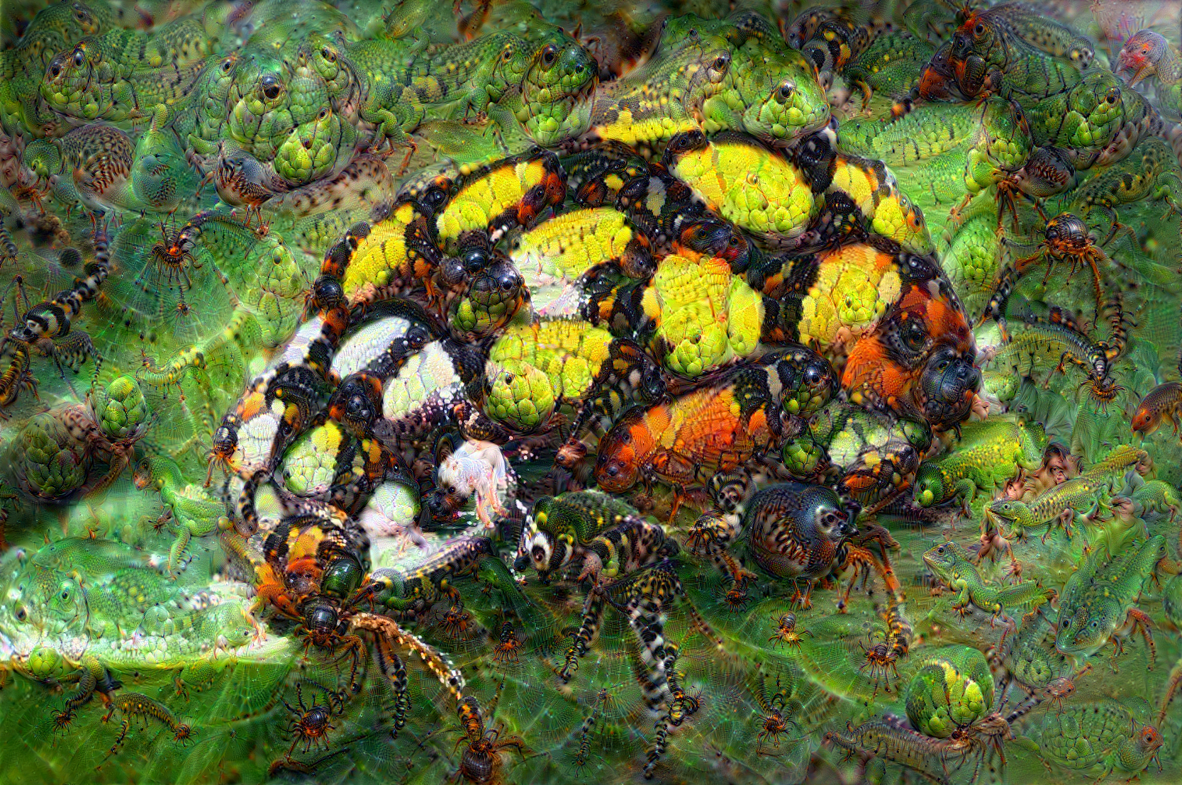
Visualizing features
Using gradient ascent we can visualize the features learned by a classifier trained on ImageNet
Slide credit: L. Lazebnik
Notes:
27

Slide 28
Embeddings without labels
Embeddings are the first step to perform tasks on images, video, audio and sequences, as the embeddings generate a space, usually referred to as latent space, summarizing useful information about the data point while rejecting unimportant information
Can we generate an embedding without creating a classifier?
Slide credit: L. Lazebnik
Notes:
28

Slide 29
Training on a different dataset
The simplest approach is to train on a dataset that has labels and then using the network to calculate embeddings for the unlabled dataset.
I’m going to use images as an example as they are easier to understand, but the techniques shown today apply to all types of data .
The most common dataset is Imagenet. Despite the quality of the features learned, sometimes the features useful for classifying animals are not the ones that are necessary to solve our task.
Slide credit: L. Lazebnik
Notes:
29

Slide 30
Contrastive Learning
We can teach the network how to identify unimportant information by creating a dataset containing some images and various augmentations of such images, and then using a loss function that ensures augmentations of the same images are close together in the latent space, while different images are further away.
Slide credit: L. Lazebnik
Notes:
30

Slide 31
Non Contrastive Learning
Creating a pretext task can also be used to create meaningful embeddings. Notable examples include predicting the rotation, translation or swapping of image patches.
Slide credit: L. Lazebnik
Notes:
31

Slide 32
Unpaired Data

Slide 33
Unpaired Data
What if we want to learn a mapping between two types of data, but we do not have corresponding examples?
We saw in the lesson about GANs that an adversarial loss can measure how close an image is to a distribution of images. By employing adversarial loss we can do domain translation without the need for matching human labeled examples.
Slide credit: L. Lazebnik
Notes:
33

